Slide 1
APUSH Review: Henry Clay’s American System (Part of Key Concept 4.2)
Everything You Need To Know About Henry Clay’s American System To Succeed In APUSH

Slide 2

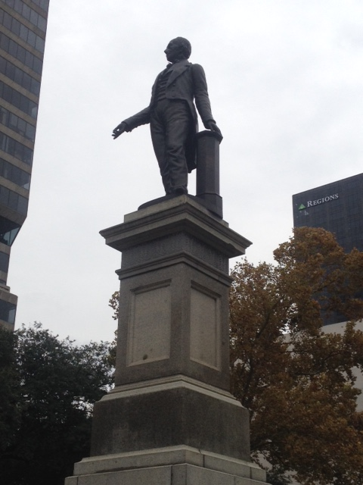
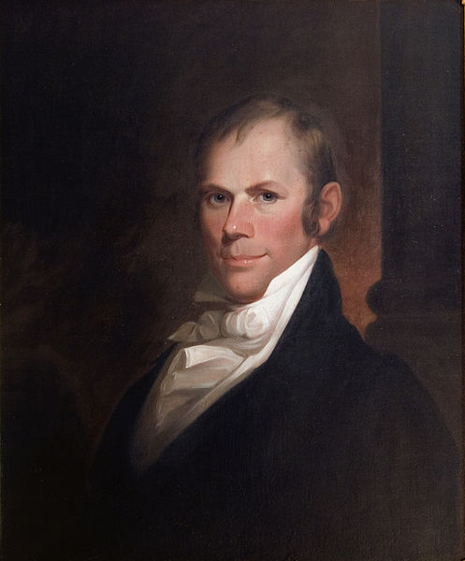
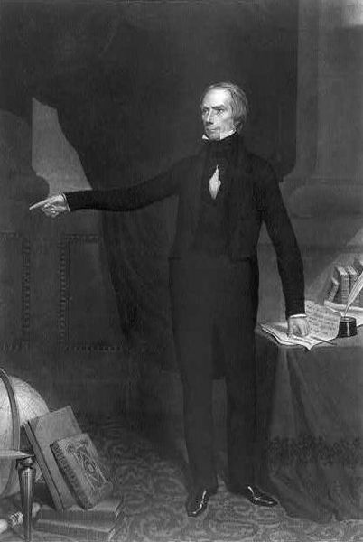
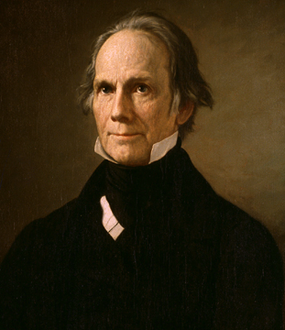
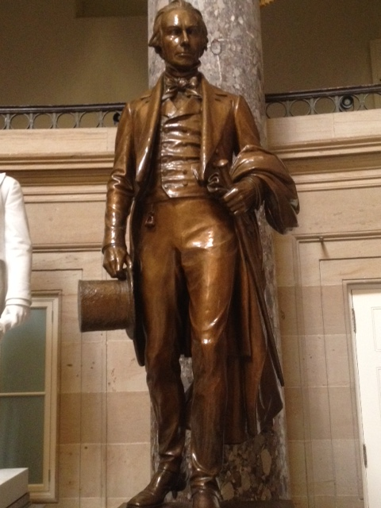
The New Curriculum
Key Concept 4.2, II, B. “Despite some governmental and private efforts to create a unified national economy, most notably the AMERICAN SYSTEM, the shift to market production linked the North and Midwest more closely than either was linked to the South.”
Page 51 of the Curriculum Framework
As with all terms/concepts/people mentioned in the white part of the curriculum, you are expected to be familiar with the American System
Plus it’s Henry Clay…

Slide 3
Background Info
During the early 19th century, the country was still growing and faced many challenges:
Infant US industries had a hard time competing with British goods
The infrastructure was weak (especially in the West – KY, OH, TN, etc.)
The first Bank of the US (BUS) expired and a 2nd one was recharted in 1816 for 20 years (would expire in 1836)
The goal of the American System was to address these areas
There was opposition to parts (or all) of the plan based on region and view of government

Slide 4
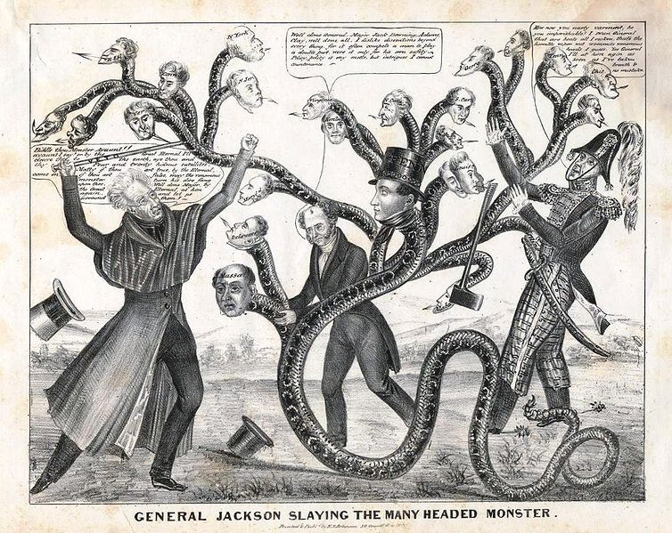
Part I of the American System: The BUS
Quick Review: The 1st BUS created divisions between Secretary of State Jefferson and Secretary of Treasury Hamilton in Washington’s administration
Debate over strict v. loose interpretation of the Constitution
Henry Clay was a supporter of the BUS and advocated for a 3rd BUS in the 1830s (See APUSH Review: Andrew Jackson and the Bank War)
Although the Supreme Court upheld the constitutionality of the BUS in McCulloch v. Maryland, there was significant opposition to the BUS
Andrew Jackson
Ultimately, the BUS ended in 1836

Slide 5
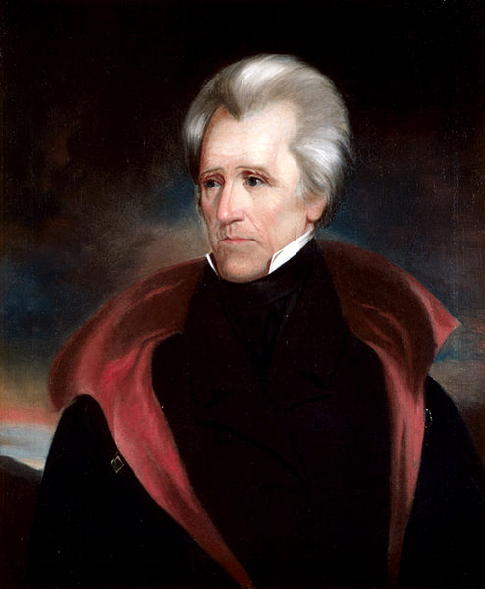
Part II of the American System: Infrastructure
Inter v. Intra state trade:
Interstate trade involves trade between two or more states
Intrastate trade involves trade within a state
For much of early American history, Congress only provided funding for interstate developments……..
Maysville Road veto:
Congressional bill that would provide funding for a road entirely in Kentucky
Is this inter or intrastate trade?
President Andrew Jackson vetoed it because it was an example of an intrastate infrastructure
Henry Clay was mad….
How would funding be provided for these internal improvements?
Tariffs!

Slide 6
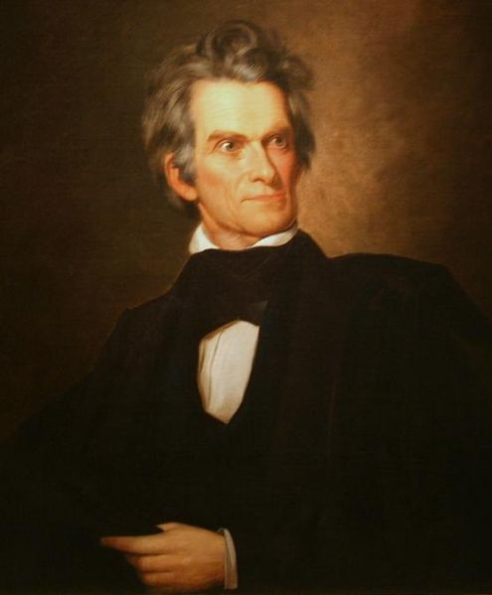
Part III of the American System: Tariffs
Tariffs and Excise Taxes:
Tariff:
Tax on foreign goods
Price of foreign goods increases, provides revenue for government, and makes American products more appealing
Excise Tax:
Tax on domestically manufactured goods (whiskey)
Why was there a need for tariffs in the early 19th century (1800s?)
American industries were young
Foreign goods were often cheaper
Britain flooded the US market after the War of 1812
Did everyone love tariffs?
NO! (See The Nullification Crisis)
The South in particular was outspoken against tariffs

Slide 7
Analyzing the American System
Successes:
The Northeast and Midwest was more closely linked
Many states built up their infrastructures
First of many government sponsored programs in the economy
American industries were able to prosper
Failures:
Did not unify all areas of the US
Sectionalism increased – Nullification Crisis (Calhoun and South Carolina)
Continued debates about role of federal government in intrastate business

Slide 8
Test Tips
Multiple-Choice Questions and Short Answer:
Know the following:
The American System attempted to help create a unified national economy
The North and Midwest benefitted the most from the system
Opposition persisted, especially in the South
Explain the various regional views of the economy and Market Revolution
Reasons for the successes and failures of the American System
Essay Questions:
Part of a broader topic: Regional differences during the Antebellum Era

Slide 9
Thanks for watching!
Subscribe to my channel
Help spread the word
Questions? Comments?
Leave in comments
Come visit me in the Capitol Building.
Subscribe
Down here!

